Slide 1
Developing a software that can translate resource material and other texts from English to other Indian regional languages.
PIP2001 Capstone Project
Review-3
Roll Number | Student Name
20211CSE0483 | JALADANGI ABDULLA
20221LCS0025 20211CSE0293 | MD MAAZ SYED TASEEN SAQQUAF
Under the Supervision of,
Ms. Galiveeti Poornima
Assistant Professor
School of Computer Science and Engineering
Presidency University
Name of the Program: CSE
Name of the HoD: Dr.Asif Mohammed H.B
Name of the Program Project Coordinator: Mr. Amarnath J.L & Dr. Jayanthi. K.
Name of the School Project Coordinators: Dr. Sampath A K / Dr. Abdul Khadar A / Mr. Md Ziaur Rahman

Slide 2
Content | Index
Hardware and Software Requirements
Architecture
Modules
UML Diagram
Timeline of the project ( Gantt Chart)
Conclusion
Abstract
Objective of project
Problem Statement
github link
Introduction
Existing Method
Disadvantages
Proposed method
Advantages

Slide 3
Abstract and Objective of project
ABSTARCT:
India is a highly diverse country with multiple regional languages spoken across different states. However, a significant portion of educational, legal, and informational resources is primarily available in English. This creates a major language barrier for individuals who are not proficient in English, limiting their access to crucial knowledge and services.
Many essential materials, such as government documents, legal notices, educational textbooks, and industry reports, remain inaccessible to a large section of the population. Existing translation tools often fail to capture the contextual meaning of the text, resulting in inaccurate or confusing translations. Additionally, many documents exist in formats like PDFs or scanned images, which require advanced text extraction capabilities before translation.
The lack of reliable, context-aware translation software prevents effective communication and knowledge dissemination, impacting students, professionals, policymakers, and the general public. To bridge this gap, there is a need for an AI-powered translation system that can accurately convert English-language resources into major Indian languages while preserving meaning and readability. This solution will enhance accessibility, promote inclusivity, and ensure that critical information reaches a wider audience.
Keywords: Machine Translation, Natural Language Processing (NLP), Artificial Intelligence (AI), Multilingual Support, Optical Character Recognition (OCR), Context-Aware Translation, Indian Regional Languages, Language Accessibility, Knowledge Dissemination, Educational Resources, Legal Document Translation, Text Extraction.
OBJECTIVE OF PROJECT :
To develop an AI-powered, context-aware translation system that accurately converts English resource materials into major Indian regional languages, ensuring accessibility and readability for diverse linguistic communities.

Slide 4
Github Link
Github Link
https://github.com/Abdulla2403/Multilingual-Translation-System.

Slide 5
INTRODUCTION
India is a multilingual country where many important educational, legal, and informational resources are available primarily in English. This creates a language barrier, making it difficult for non-English speakers to access and understand crucial information. To address this issue, we propose the development of a translation software that can convert resource materials from English to major Indian regional languages, including Hindi, Marathi, Bengali, Gujarati, Tamil, and Telugu.
The software will support various formats such as Word documents, PDFs, and text extracted from images. Unlike basic translation tools that provide word-for-word translations, this system will focus on context-aware translation, ensuring that the meaning is preserved while keeping the language simple and easy to understand. The goal is to make the content accessible to the general public without using complex or colloquial terms.
To achieve this, the software will integrate Artificial Intelligence (AI), Natural Language Processing (NLP), and Optical Character Recognition (OCR) for text extraction and accurate translation. By providing clear and meaningful translations, this solution aims to improve awareness, education, and legal understanding across diverse linguistic communities in India.
This project will play a crucial role in making important information available to a larger audience, including students, industries, law enforcement, and policymakers, ultimately helping to bridge the language gap in knowledge dissemination.

Slide 6
Existing method and Disadvantages in it
Existing Method and Disadvantages
Currently, users rely on basic translation tools like Google Translate or manual translation services to convert resource materials into Indian languages. These methods often fail to preserve the context, accuracy, and readability of the original content. Additionally, they struggle with multi-format documents such as PDFs, scanned images, and structured reports, making it difficult to extract and translate text effectively.
Disadvantages:
Lack of Context Awareness: Generic translation tools provide word-for-word translations, often leading to misinterpretations.
Inaccuracy in Technical and Legal Documents: Critical information in legal, educational, or official documents may get distorted due to incorrect phrasing.
Limited Support for Multi-Format Documents: Many existing tools do not effectively process text from PDFs, scanned images, or structured reports.
Inconsistent Formatting: Translated content often loses its original structure, making it difficult to read and use.
Time-Consuming Manual Efforts: Manual translation is slow, costly, and not scalable for large volumes of content.
A unified, AI-powered solution is required to ensure accurate, context-aware, and scalable translation while preserving document structure and readability.

Slide 7
Proposed method and Advantages in it
TheProposed Method:
The system will integrate AI, NLP, and OCR technologies to convert resource materials from English into languages such as Hindi, Marathi, Bengali, Gujarati, Tamil, and Telugu. It will support various formats, including Word documents, PDFs, and text extracted from images. The focus will be on context-aware translation to preserve meaning while simplifying the language for better understanding2.
Advantages:
Improved Data Accessibility and Availability: By breaking down language silos, the platform provides a centralized and accessible repository of translated information, enabling users across various linguistic communities to quickly locate and work with the data3.
Seamless User Experience: A unified platform delivers a consistent experience2. Users can access various services through a single interface, reducing complexity and enhancing convenience4. The transition between different languages and resources is smooth, maintaining a consistent brand image2.
Enhanced Agility and Scalability: Unified platforms provide businesses with the agility and scalability needed to adapt to changing market dynamics and emerging technologies2.
Increased Operational Efficiency: The unified system streamlines the translation process and data management3. Centralized management and automated workflows reduce the time and effort required to manage and monitor translations, improving overall productivity2.
Enhanced Data Quality and Consistency: Organizations can identify and resolve inconsistencies and errors by integrating data from various sources within the unified platform3. Data cleansing and standardization processes improve accuracy, ensuring reliable and consistent information3.

Slide 8
HARDWARE & SOFTWARE REQUIREMENTS
SOFTWARE REQUIREMENS
Operating System - Windows 10
JDK - Java(kotlin)
SDK - Android
IDE - Android studio
Database - my SQL
HARDWARE REQUIREMENTS
Processor - I3/Intel Processor
RAM - 8 GB
Hard Disk - 1TB

Slide 9
Modules
Resource Upload Module:
Functionality: Allows administrators and authorized users to upload resource materials in English, supporting formats like Word documents, PDFs, and images.
Features: Batch upload capability, format validation, and metadata tagging for categorization.
Translation Engine Module:
Functionality: Utilizes AI, NLP, and OCR technologies to extract text from uploaded resources and perform context-aware translations into selected Indian languages.
Features: Language selection, translation progress tracking, and quality check options.
Language Management Module:
Functionality: Manages the available Indian languages, updates terminology, and refines translation algorithms.
Features: Language pack installation, terminology database, and AI model training interface.
User Access Module:
Functionality: Manages user registration, login, and access permissions to different features and language sets.
Features: Role-based access control, user activity tracking, and language preference settings.
Review and Editing Module:
Functionality: Enables reviewers and editors to proofread and refine the translated content, ensuring accuracy and readability.
Features: Side-by-side comparison of original and translated text, editing tools, and version control.
Output and Distribution Module:
Functionality: Generates translated documents in various formats and facilitates distribution through different channels.
Features: Format conversion (e.g., PDF, Word), download options, and API integration for content sharing.

Slide 10
UML DIAGRAMS
Use Case Diagram:
A use case diagram in the Unified Modeling Language (UML) is a type of behavioral diagram defined by and created from a Use-case analysis. Its purpose is to present a graphical overview of the functionality provided by a system in terms of actors, their goals (represented as use cases), and any dependencies between those use cases. The main purpose of a use case diagram is to show what system functions are performed for which actor. Roles of the actors in the system can be depicted.

Slide 11
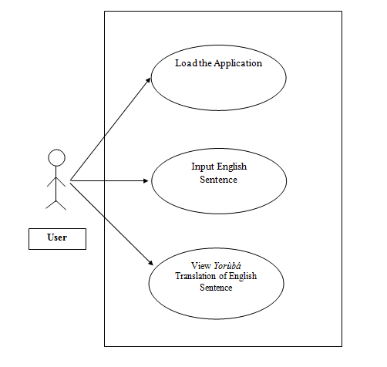
UML DIAGRAMS
Figure: Use Case Diagram

Slide 12
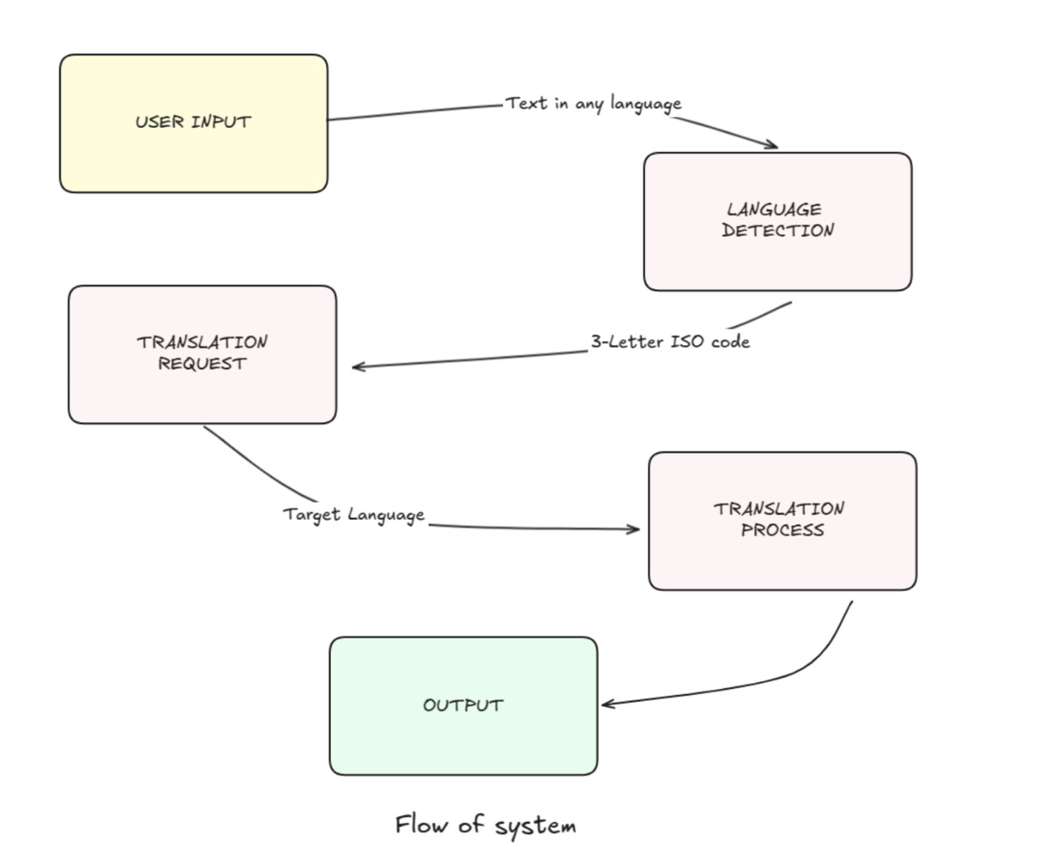
Class Diagram:
In software engineering, a class diagram in the Unified Modelling Language (UML) is a type of static structure diagram that describes the structure of a system by showing the system's classes, their attributes, operations (or methods), and the relationships among the classes. It explains which class contains information.

Slide 13
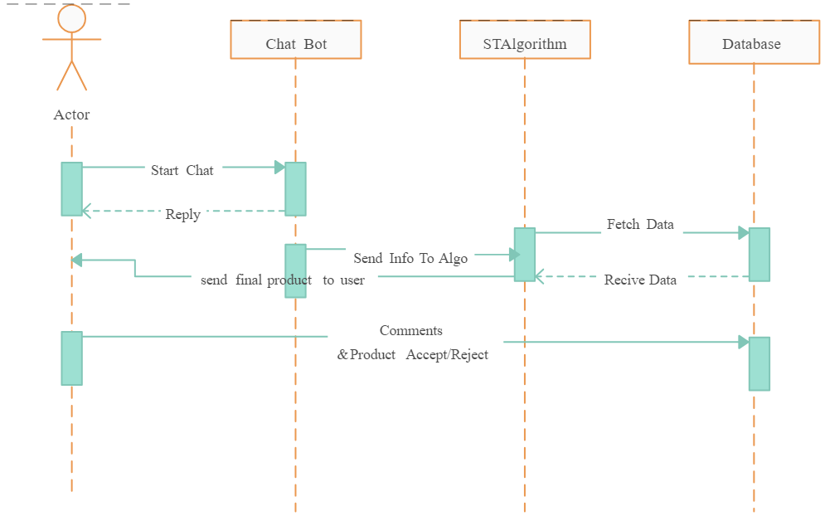
Sequence Diagram:
A sequence diagram in Unified Modelling Language (UML) is a kind of interaction diagram that shows how processes operate with one another and in what order. It is a construct of a Message Sequence Chart. Sequence diagrams are sometimes called event diagrams, event scenarios, and timing diagrams.

Slide 14
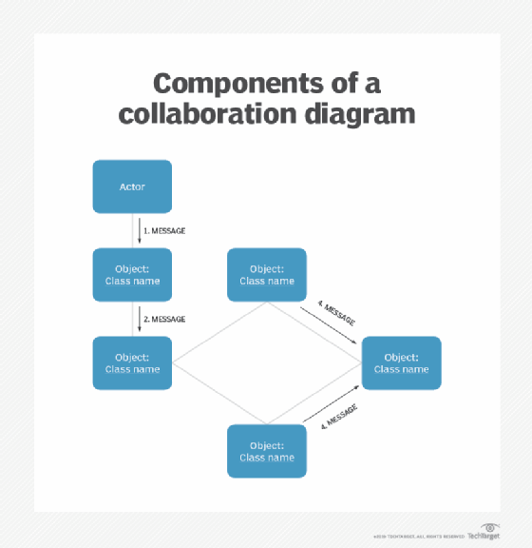
Collaboration Diagram:
In collaboration diagram the method call sequence is indicated by some numbering technique as shown below. The number indicates how the methods are called one after another. We have taken the same order management system to describe the collaboration diagram. The method calls are similar to that of a sequence diagram. But the difference is that the sequence diagram does not describe the object organization whereas the collaboration diagram shows the object organization.

Slide 15
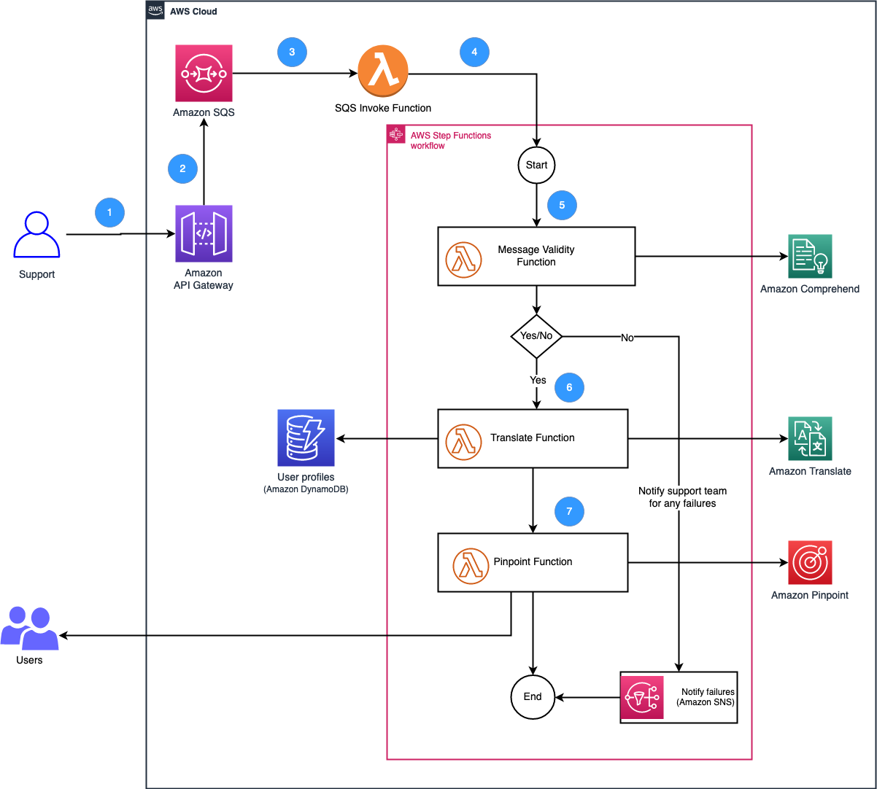
Deployment Diagram
Deployment diagram represents the deployment view of a system. It is related to the component diagram. Because the components are deployed using the deployment diagrams. A deployment diagram consists of nodes. Nodes are nothing but physical hardware’s used to deploy the application.

Slide 16
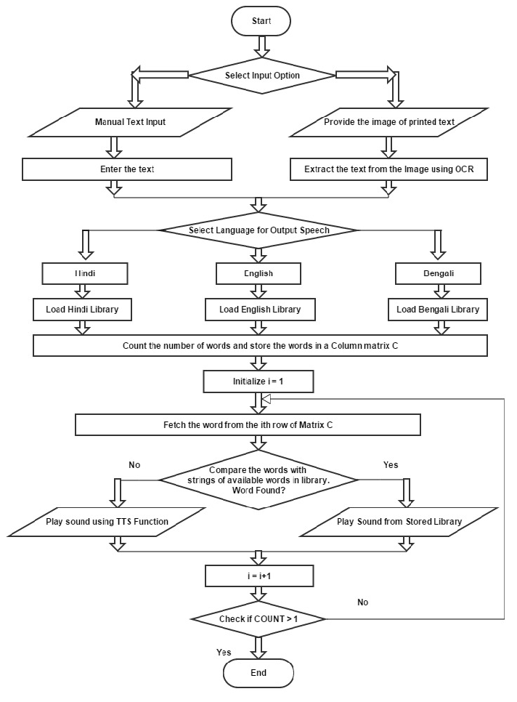
Activity Diagram:
Activity diagrams are graphical representations of workflows of stepwise activities and actions with support for choice, iteration and concurrency. In the Unified Modelling Language, activity diagrams can be used to describe the business and operational step-by-step workflows of components in a system. An activity diagram shows the overall flow of control.

Slide 17
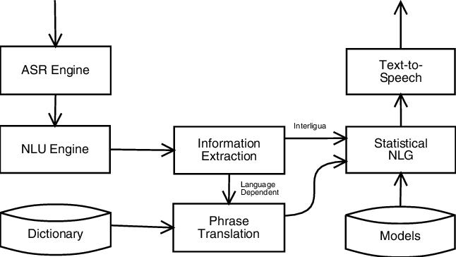
Component Diagram:
A component diagram, also known as a UML component diagram, describes the organization and wiring of the physical components in a system. Component diagrams are often drawn to help model implementation details and double-check that every aspect of the system's required functions is covered by planned development.

Slide 18
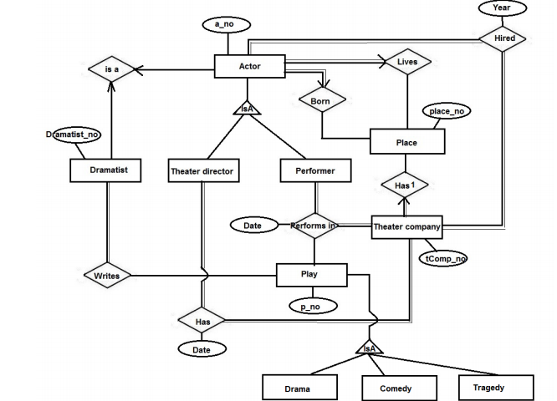
ER Diagram:
An Entity–relationship model (ER model) describes the structure of a database with the help of a diagram, which is known as Entity Relationship Diagram (ER Diagram). An ER model is a design or blueprint of a database that can later be implemented as a database. The main components of E-R model are: entity set and relationship set.
An ER diagram shows the relationship among entity sets. An entity set is a group of similar entities and these entities can have attributes. In terms of DBMS, an entity is a table or attribute of a table in database, so by showing relationship among tables and their attributes, ER diagram shows the complete logical structure of a database. Let’s have a look at a simple ER diagram to understand this concept.

Slide 19
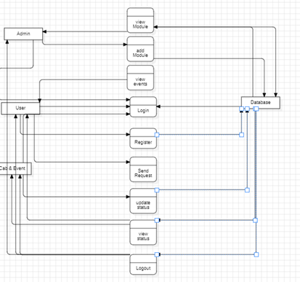
DFD Diagram:
A Data Flow Diagram (DFD) is a traditional way to visualize the information flows within a system. A neat and clear DFD can depict a good amount of the system requirements graphically. It can be manual, automated, or a combination of both. It shows how information enters and leaves the system, what changes the information and where information is stored. The purpose of a DFD is to show the scope and boundaries of a system as a whole. It may be used as a communications tool between a systems analyst and any person who plays a part in the system that acts as the starting point for redesigning a system.

Slide 20
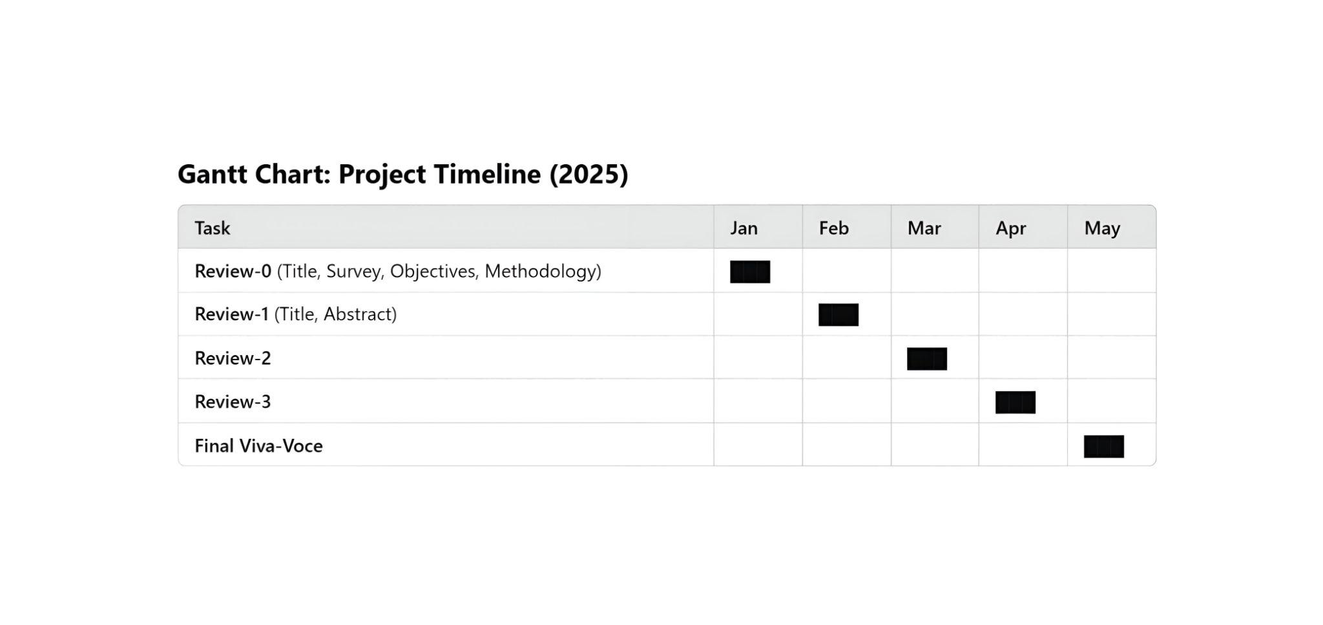
Timeline of the Project (Gantt Chart)

Slide 21
Conclusion
Conclusion: This project successfully provides Multilingual Translation System for Enhancing Knowledge Accessibility in India addresses the critical issue of language barriers by providing a unified platform for translating resources from English to major Indian regional languages. By integrating AI, NLP, and OCR technologies, the system ensures context-aware and accurate translations, making essential information accessible to a broader audience.
The project streamlines the translation process, simplifies language access, and offers streamlined management of translations. The ER diagram facilitates efficient data management, while module-based architecture allows flexibility and scalability.
By breaking down language silos and improving access to vital information, this system enhances awareness, education, and legal understanding across diverse linguistic communities in India. It empowers students, industries, law enforcement, and policymakers, bridging the knowledge gap and promoting digital inclusion. The system offers a centralized repository of translated information, allowing users to quickly find the data they need. Overall, the project plays a crucial role in democratizing knowledge and fostering a more informed and engaged society in India.

Slide 22


